Slide 1
Voice Recognition Voice Message
NYUSH ICS Final Presentation
Kaan Tekin

Slide 2
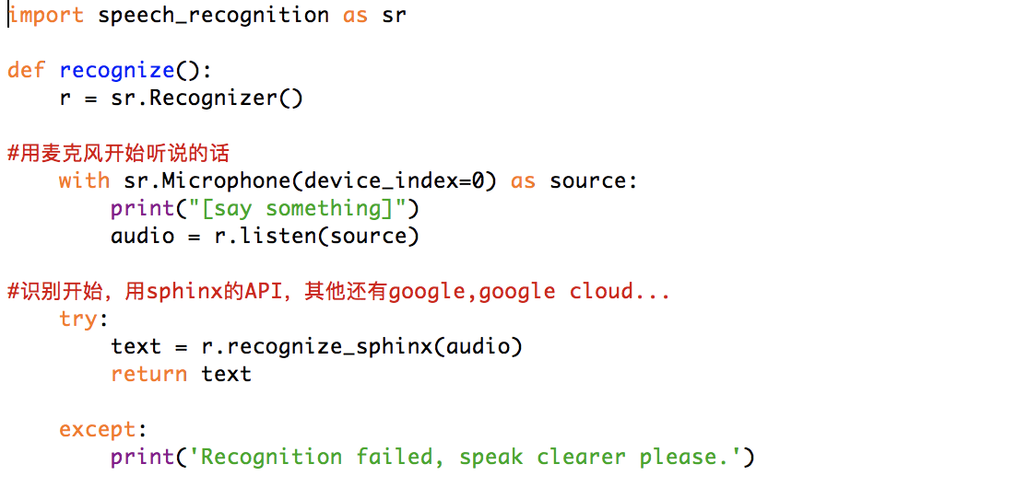
Voice Recognition
Install Speech Recognition
Import
Recording
Link to API
Return

Slide 3
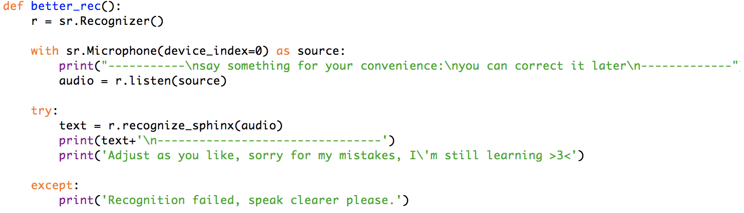
Better Recognition
Adjust Opportunity

Slide 4
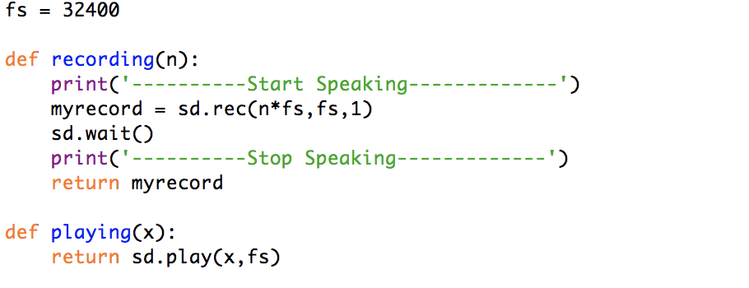
Voice Message
Install sound_device
Import
Recording
Play

Slide 5
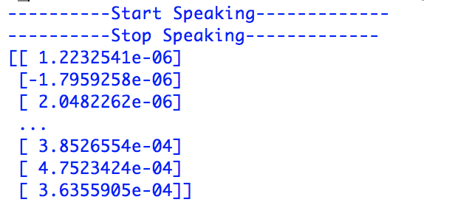
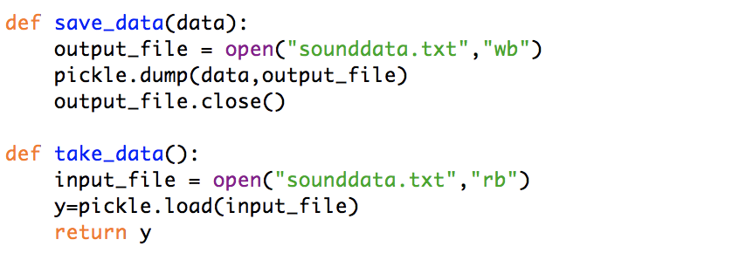
Integrating them into system
Import Pickle

Slide 6
Demo Showcase

